Slide 1

GitHub Copilot
GitHub Copilot Agent Chat modes: Agent, Plan, Edit, Ask

Slide 2
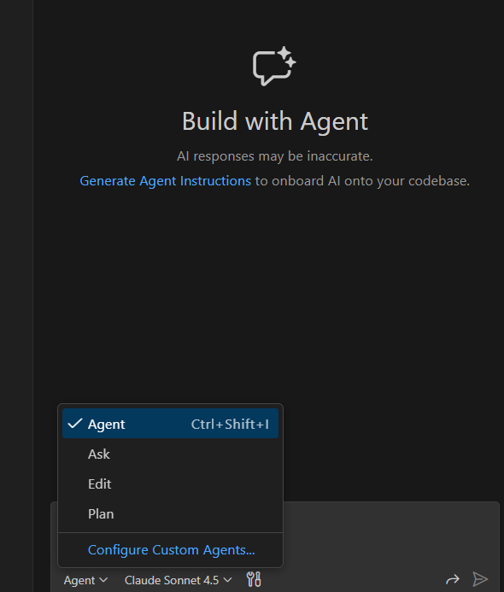

Ask mode
Ask mode is optimized for answering questions about your codebase, coding concepts, errors, and options. It typically doesn’t try to autonomously change lots of files—it’s your “talk it through” mode
“Explain what this function does / why this bug happens”
“What’s the right approach?” or “Compare options”
“Help reading stack traces, docs, or unfamiliar code.
Regular ChatGPT

Slide 3
Edit mode
Edit mode allows you to describe a desired code change in natural language and then review and apply the proposed, file-specific changes directly in your editor
  You want to make a quick, specific update to a defined set of files.
  You want full control over the number of LLM requests Copilot uses.

Slide 4
Edit mode
In agent mode, Copilot determines which files to make changes to, offers code changes and terminal commands to complete the task, and iterates to remediate issues until the original task is complete. You want to make a quick, specific update to a defined set of files.
  Your task is complex, and involves multiple steps, iterations, and error handling.
  You want Copilot to determine the necessary steps to take to complete the task.
  The task requires Copilot to integrate with external applications, such as an MCP server.

Slide 5
PLAN mode
Plan mode is a feature that creates a detailed, step-by-step implementation strategy for a given high-level task before any code is written or changed. Your task is complex, and involves multiple steps, iterations, and error handling.
  You want Copilot to determine the necessary steps to take to complete the task.
  The task requires Copilot to integrate with external applications, such as an MCP server.

